Slide 1
DigitalCast - A digital signage management platform
Datacenter Scale Computing (Fall 2024) - CSCI 5253-872
Project Participants:
Aneesh Khole
Uttara Ketkar

Slide 2
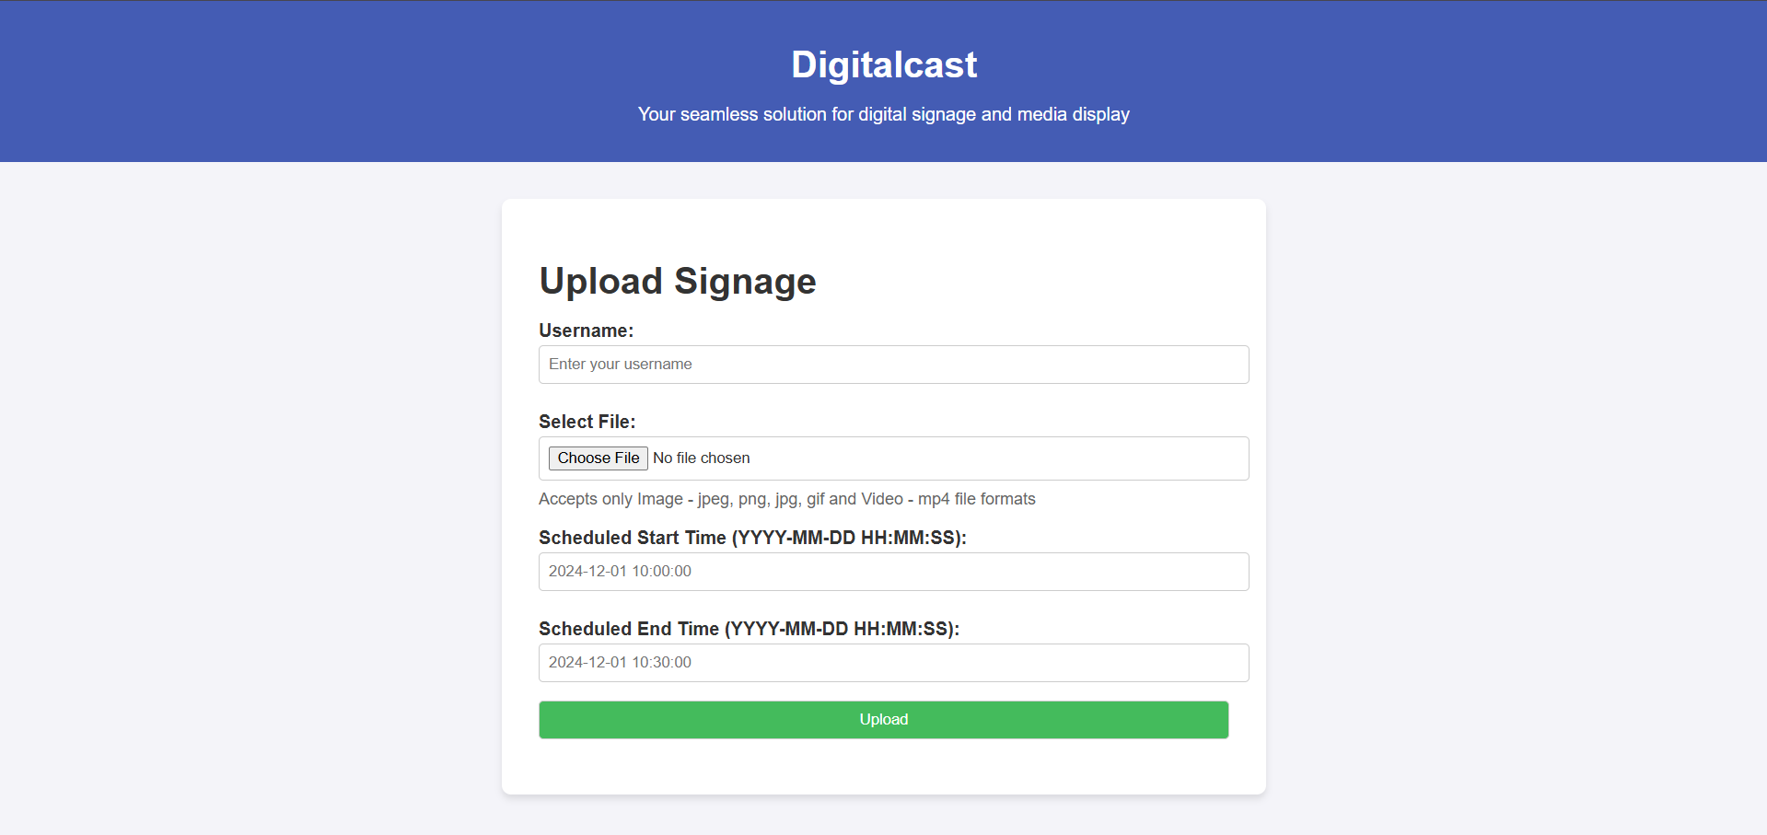
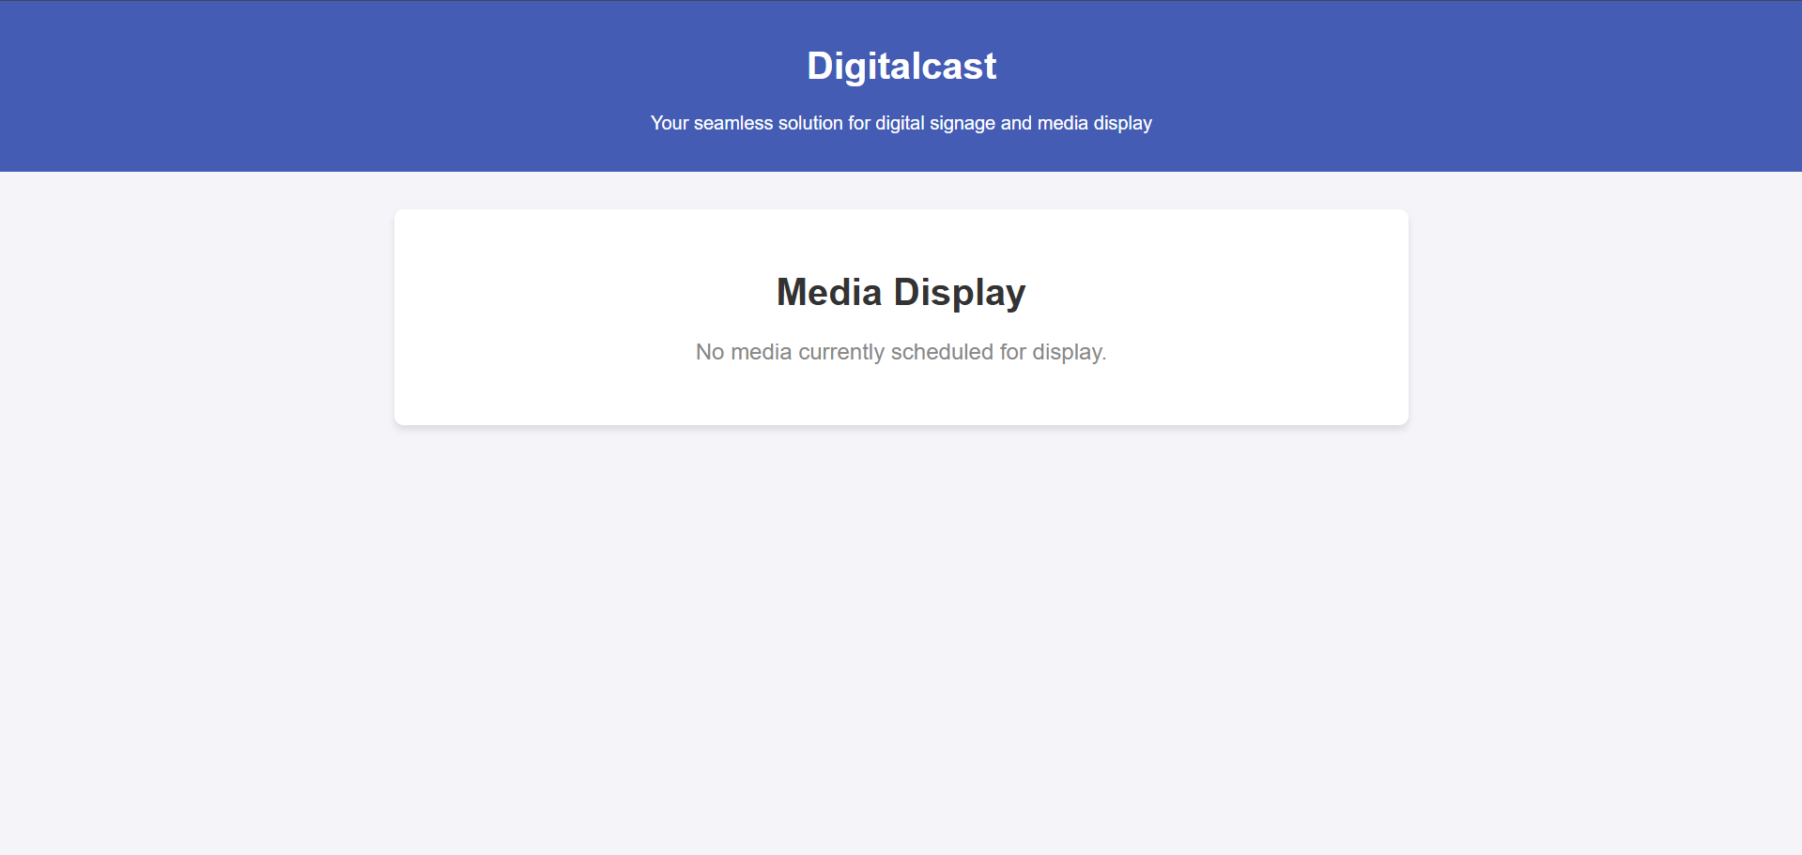
Project Goals
A user-friendly platform for uploading media files.
Scheduling capabilities to display media within defined time intervals.
A robust backend for managing metadata, media storage, and display synchronization.
Scalability and reliability using Kubernetes and GCP services.

Slide 3
Software and hardware components
Software Components
Hardware Components
Frontend
Cloud Services
upload.html
UI to upload media
display.html
UI to display scheduled media
Flask app
(REST API)
worker.py
PostgreSQL for storing metadata
GCS
Pub/Sub
Kubernetes
Database
app.py
display.py
GKE
GCP provided VMs

Slide 4
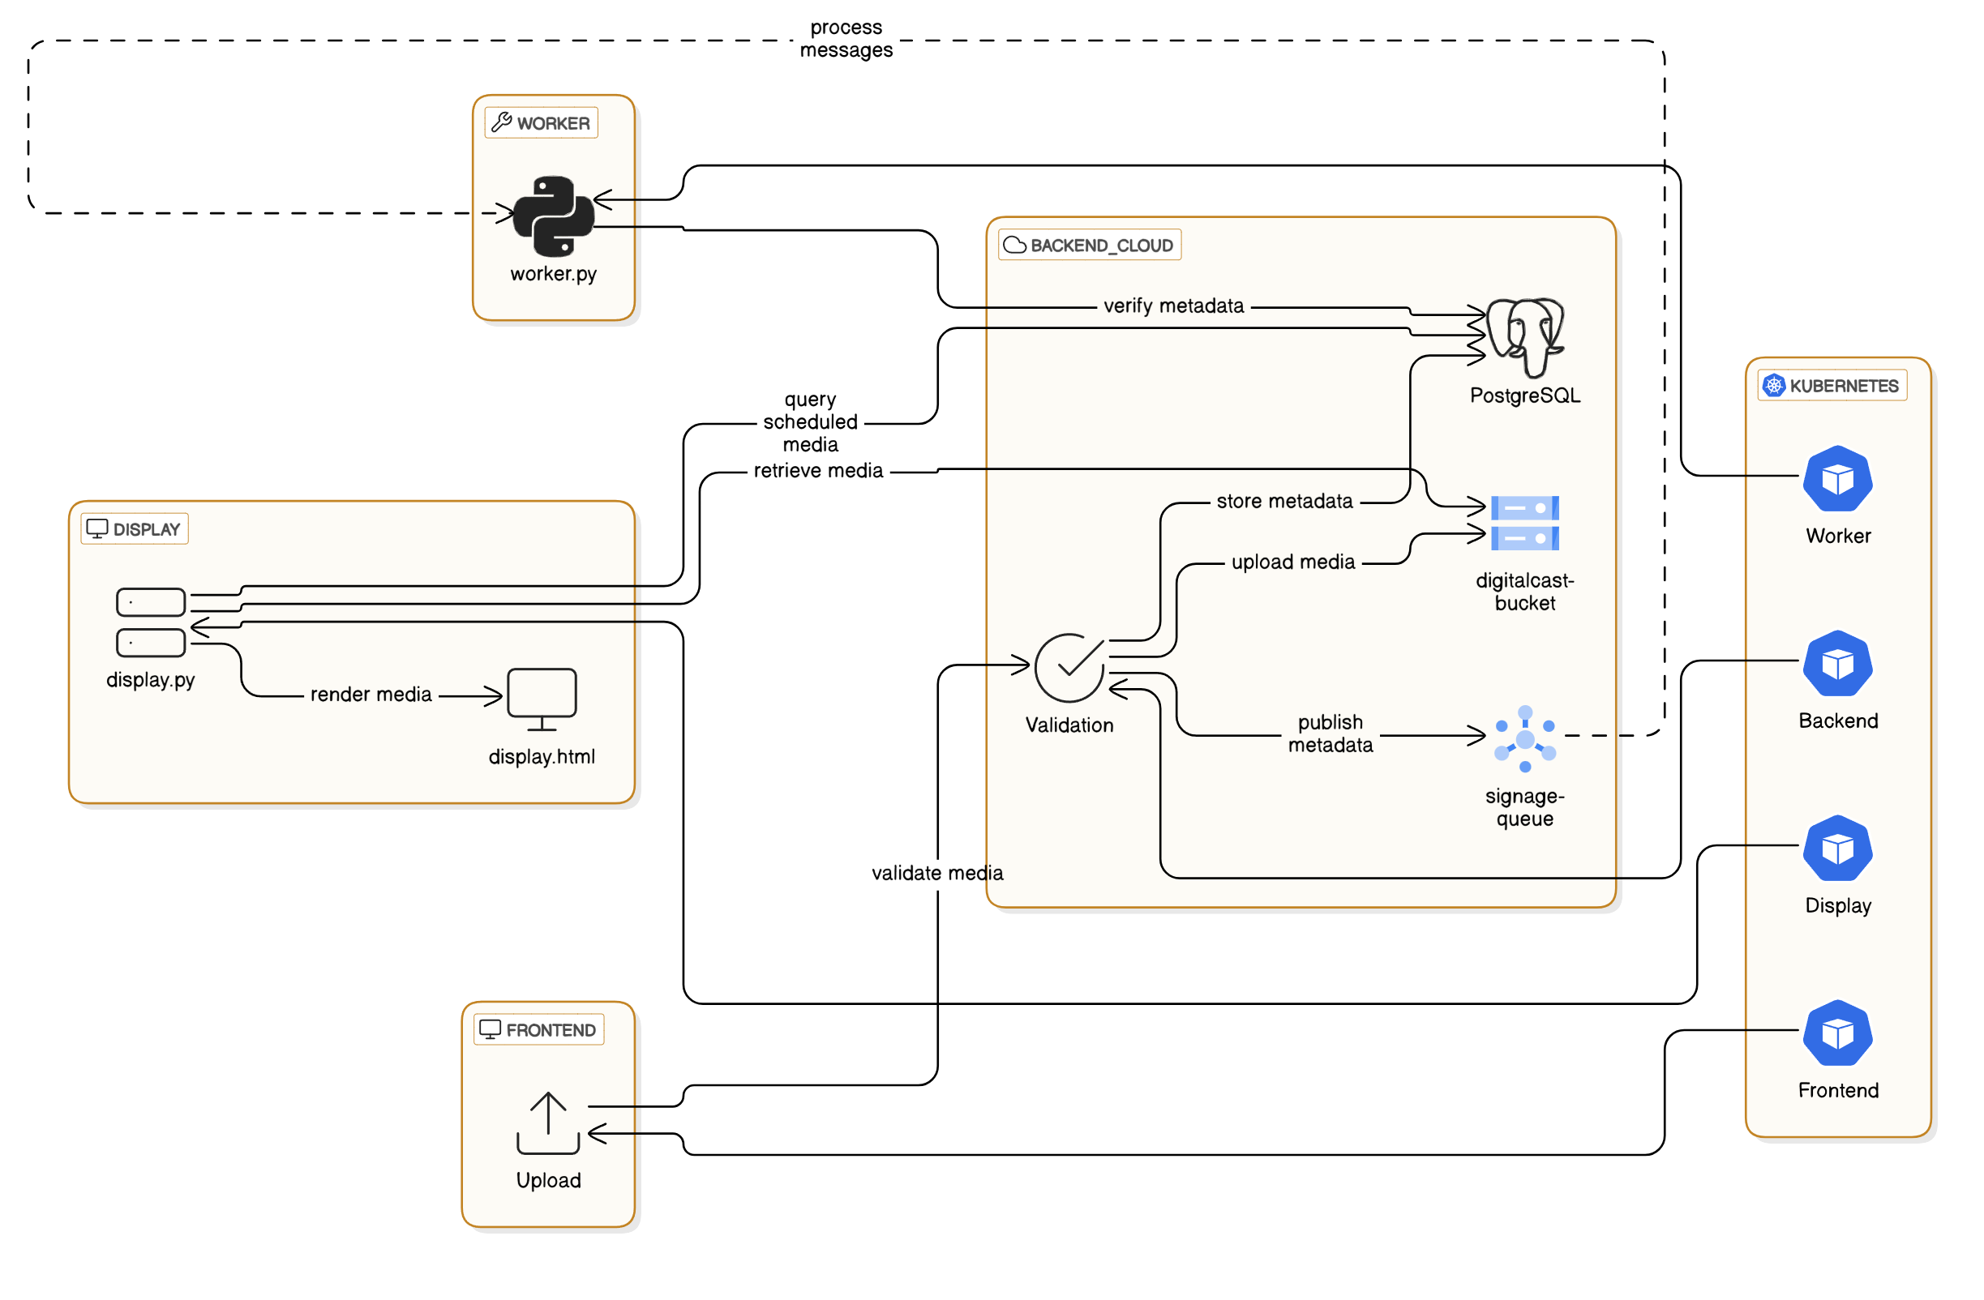
Architectural Diagram

Slide 5
Debugging and Testing
Debugging
Testing
Logging
Flask apps
Workers
REST endpoints
Database Integrity Checks
SQL queries
Validation
Error Handling
Error logging
Pub/Sub acknowledgement or retry.
Unit Tests
REST endpoint testing, component testing
Query validation
Integration Tests
Upload to Display workflow testing
Kubernetes scalability

Slide 6
System Capabilities and Bottlenecks
Capabilities
Bottlenecks
Scalability
Reliability
Flexibility
Autoscaling based on workload
Pub/Sub based two factor checking
Overlapping schedule times with distinct usernames.
Database Throughput
Latency
Storage Costs
GCS bucket costs increase with bigger media
Pub/Sub introduced delays
Concurrent uploads

Slide 7
Conclusion
Digitalcast successfully demonstrates the integration of cloud technologies to build a scalable, reliable, and user-friendly digital signage solution.
By leveraging GCP services such as Kubernetes, Pub/Sub, and Cloud Storage, the system provides an efficient platform for managing media uploads, scheduling, and displays.
Let’s head to the demo!

